Slide 1
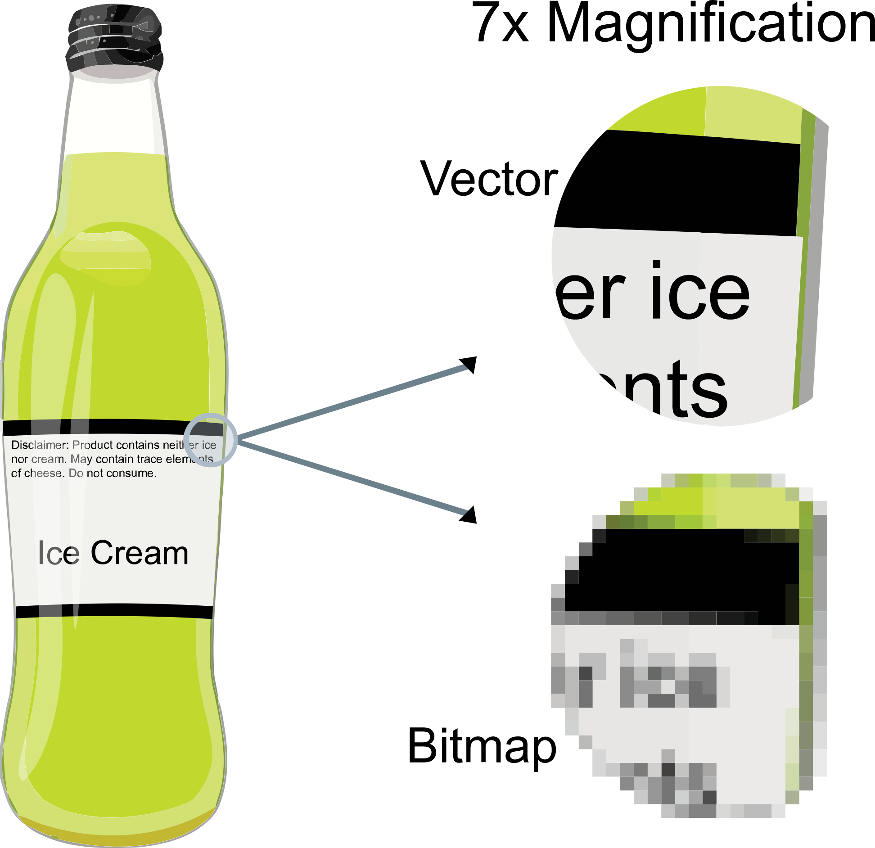
VECTORIZED IMAGES
COMMON VECTORS: .PDF, .SVG, .EPS
COMMON RASTERS:
.JPG, .PNG, .GIF

Slide 2
OPEN:
Komodo_Dragon.png Komodo_Dragon.pdf

Slide 3
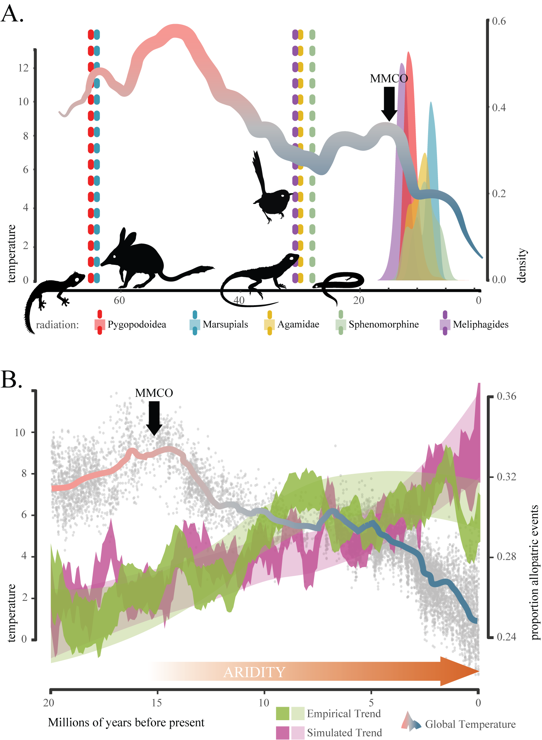
WHAT’S WRONG HERE?
CAN WE SIMPLIFY THE FIGURE?
WHAT DO WE KEEP?
WHAT HAS TO GO?

Slide 5
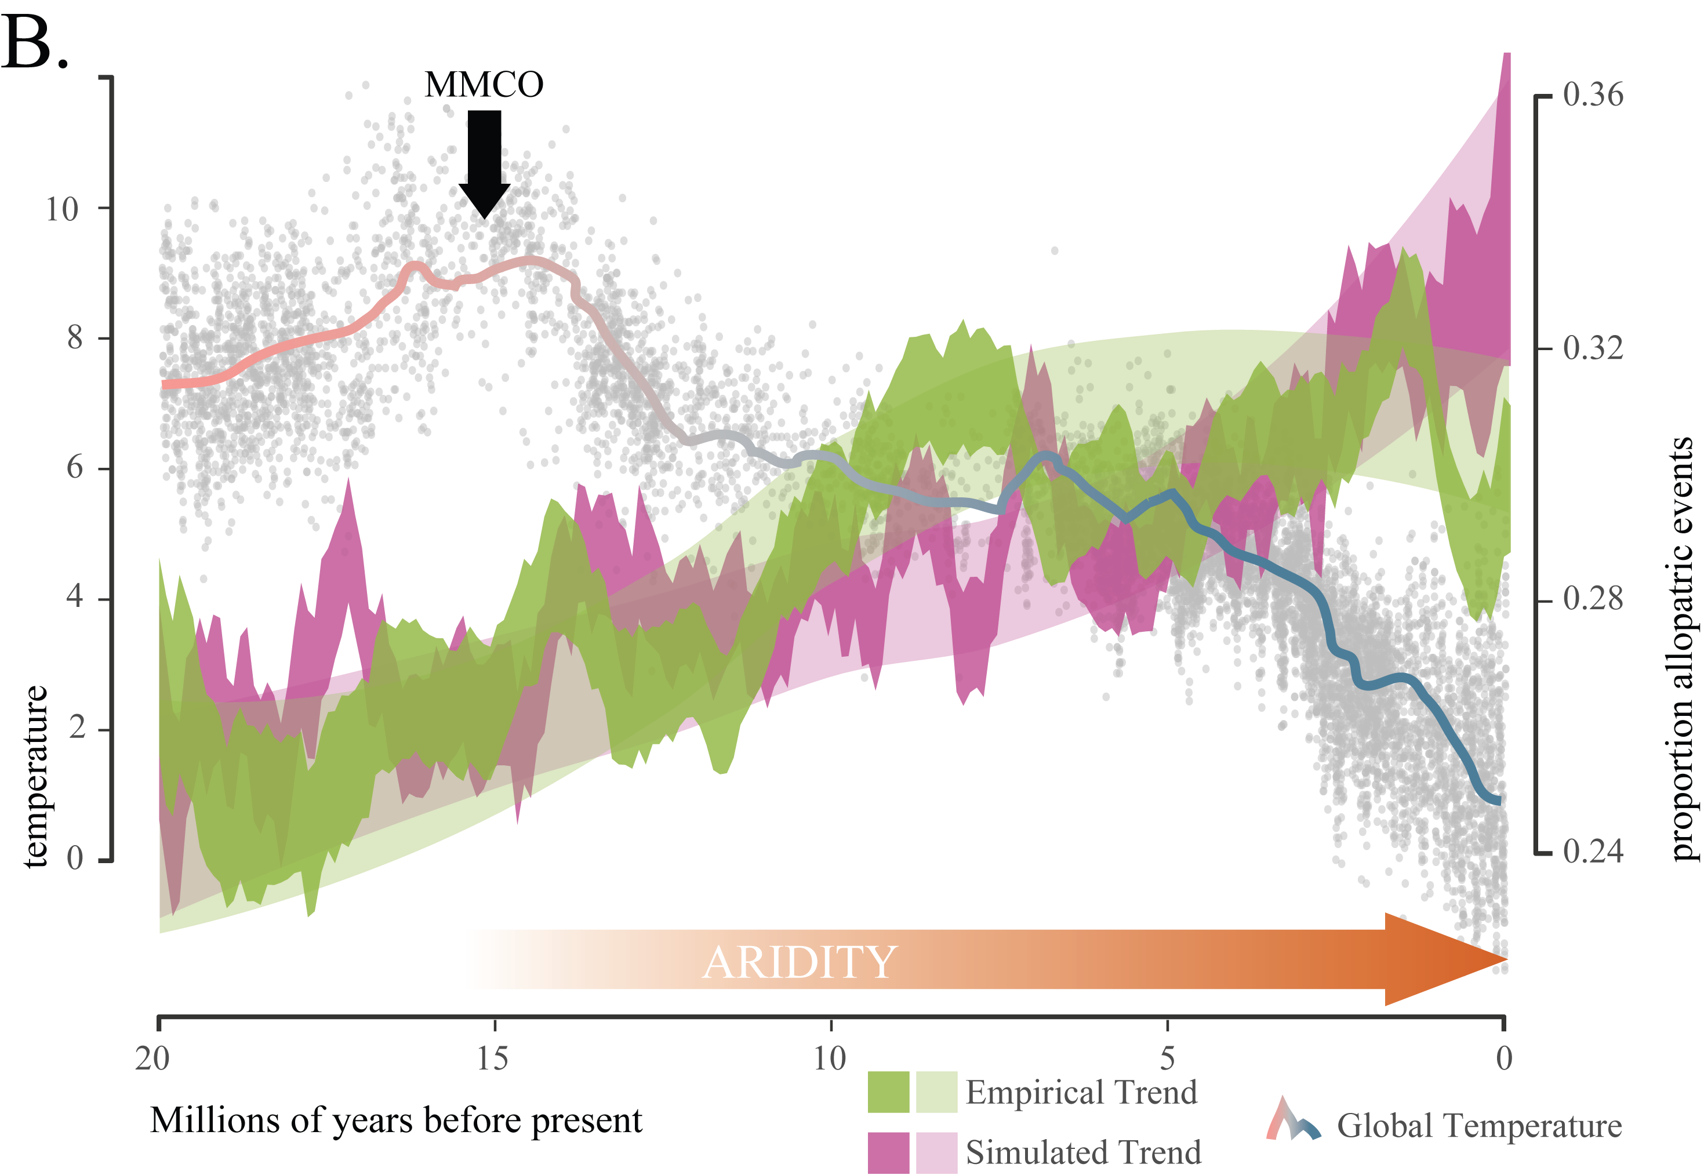

Slide 7
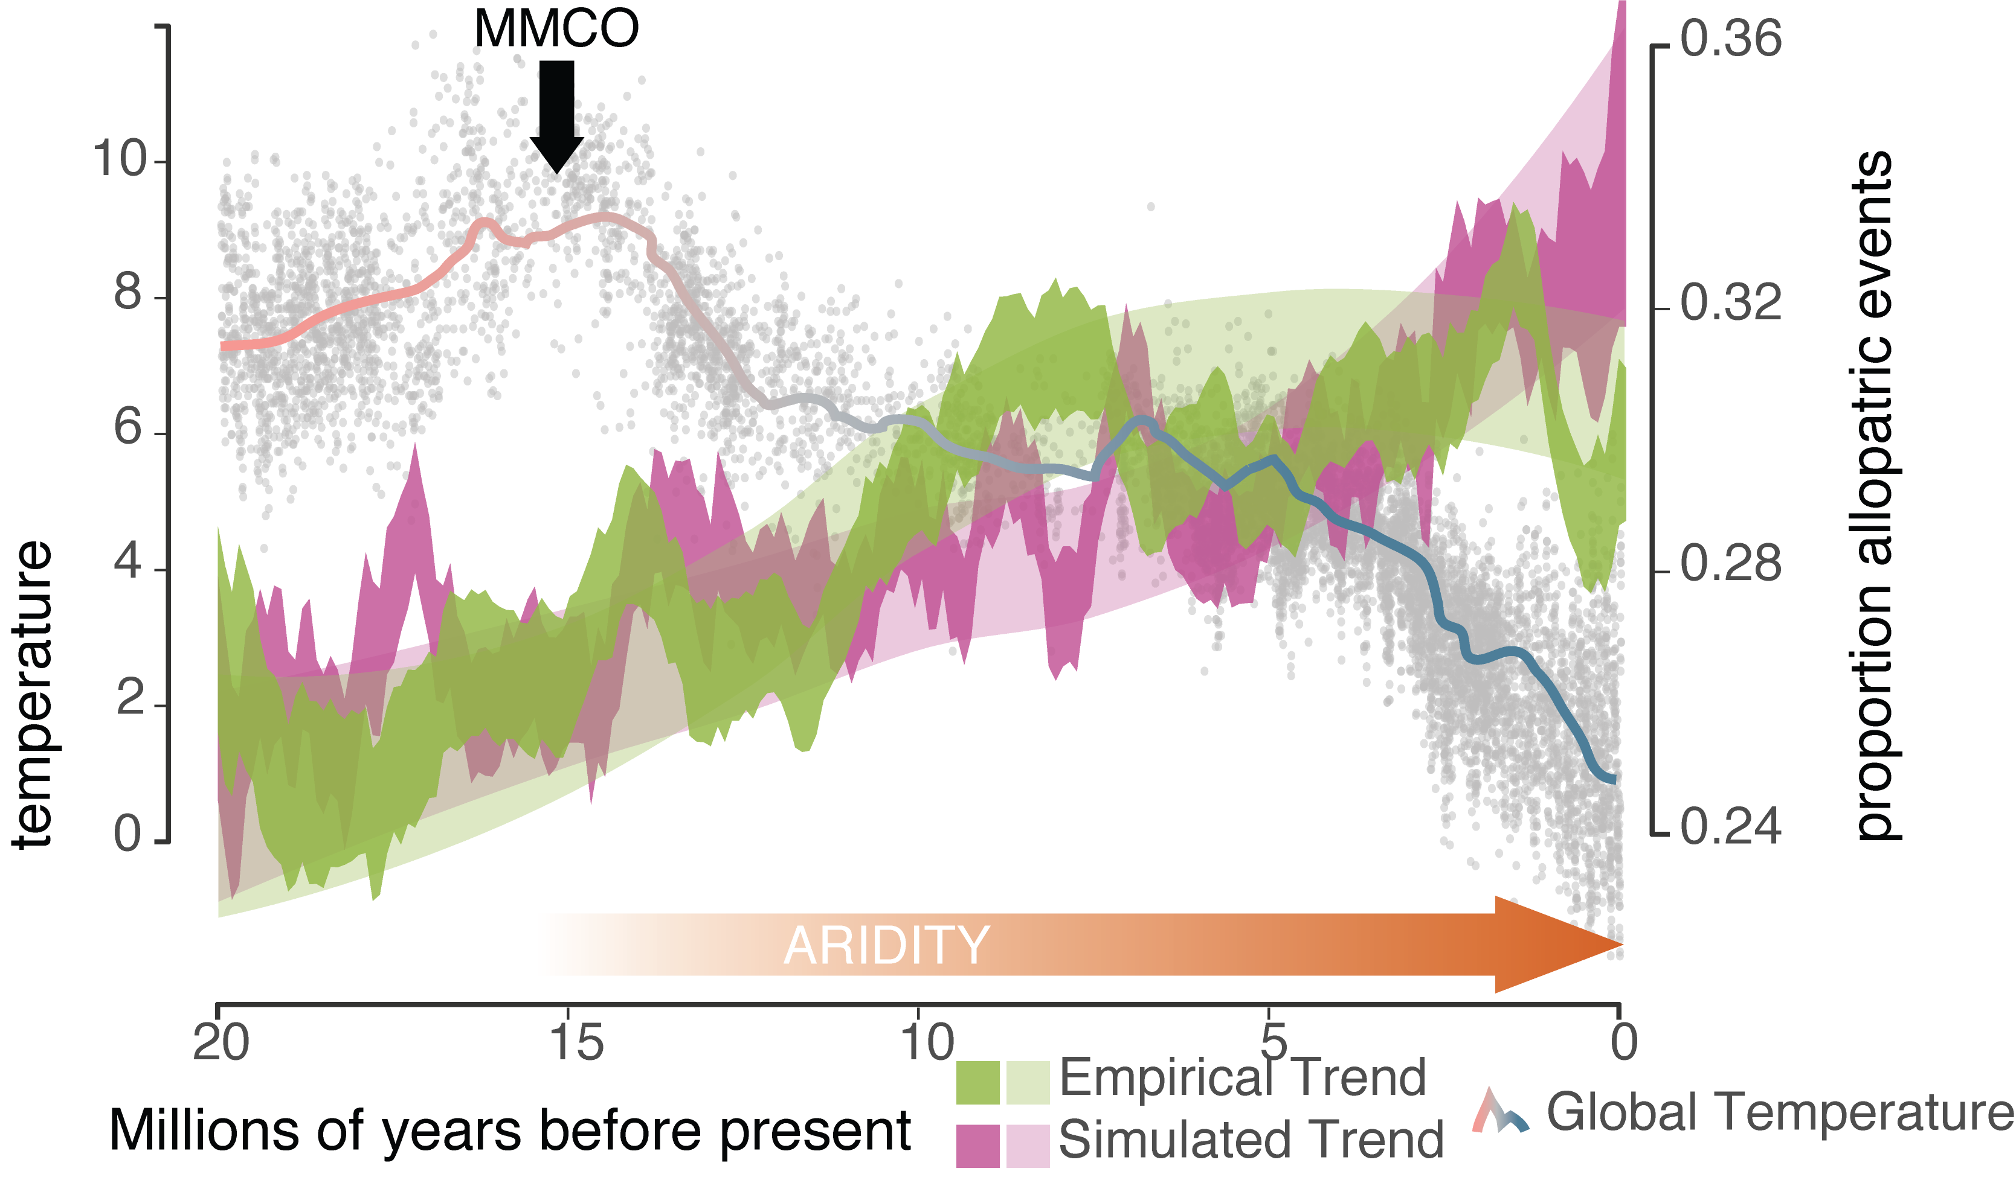

Slide 9
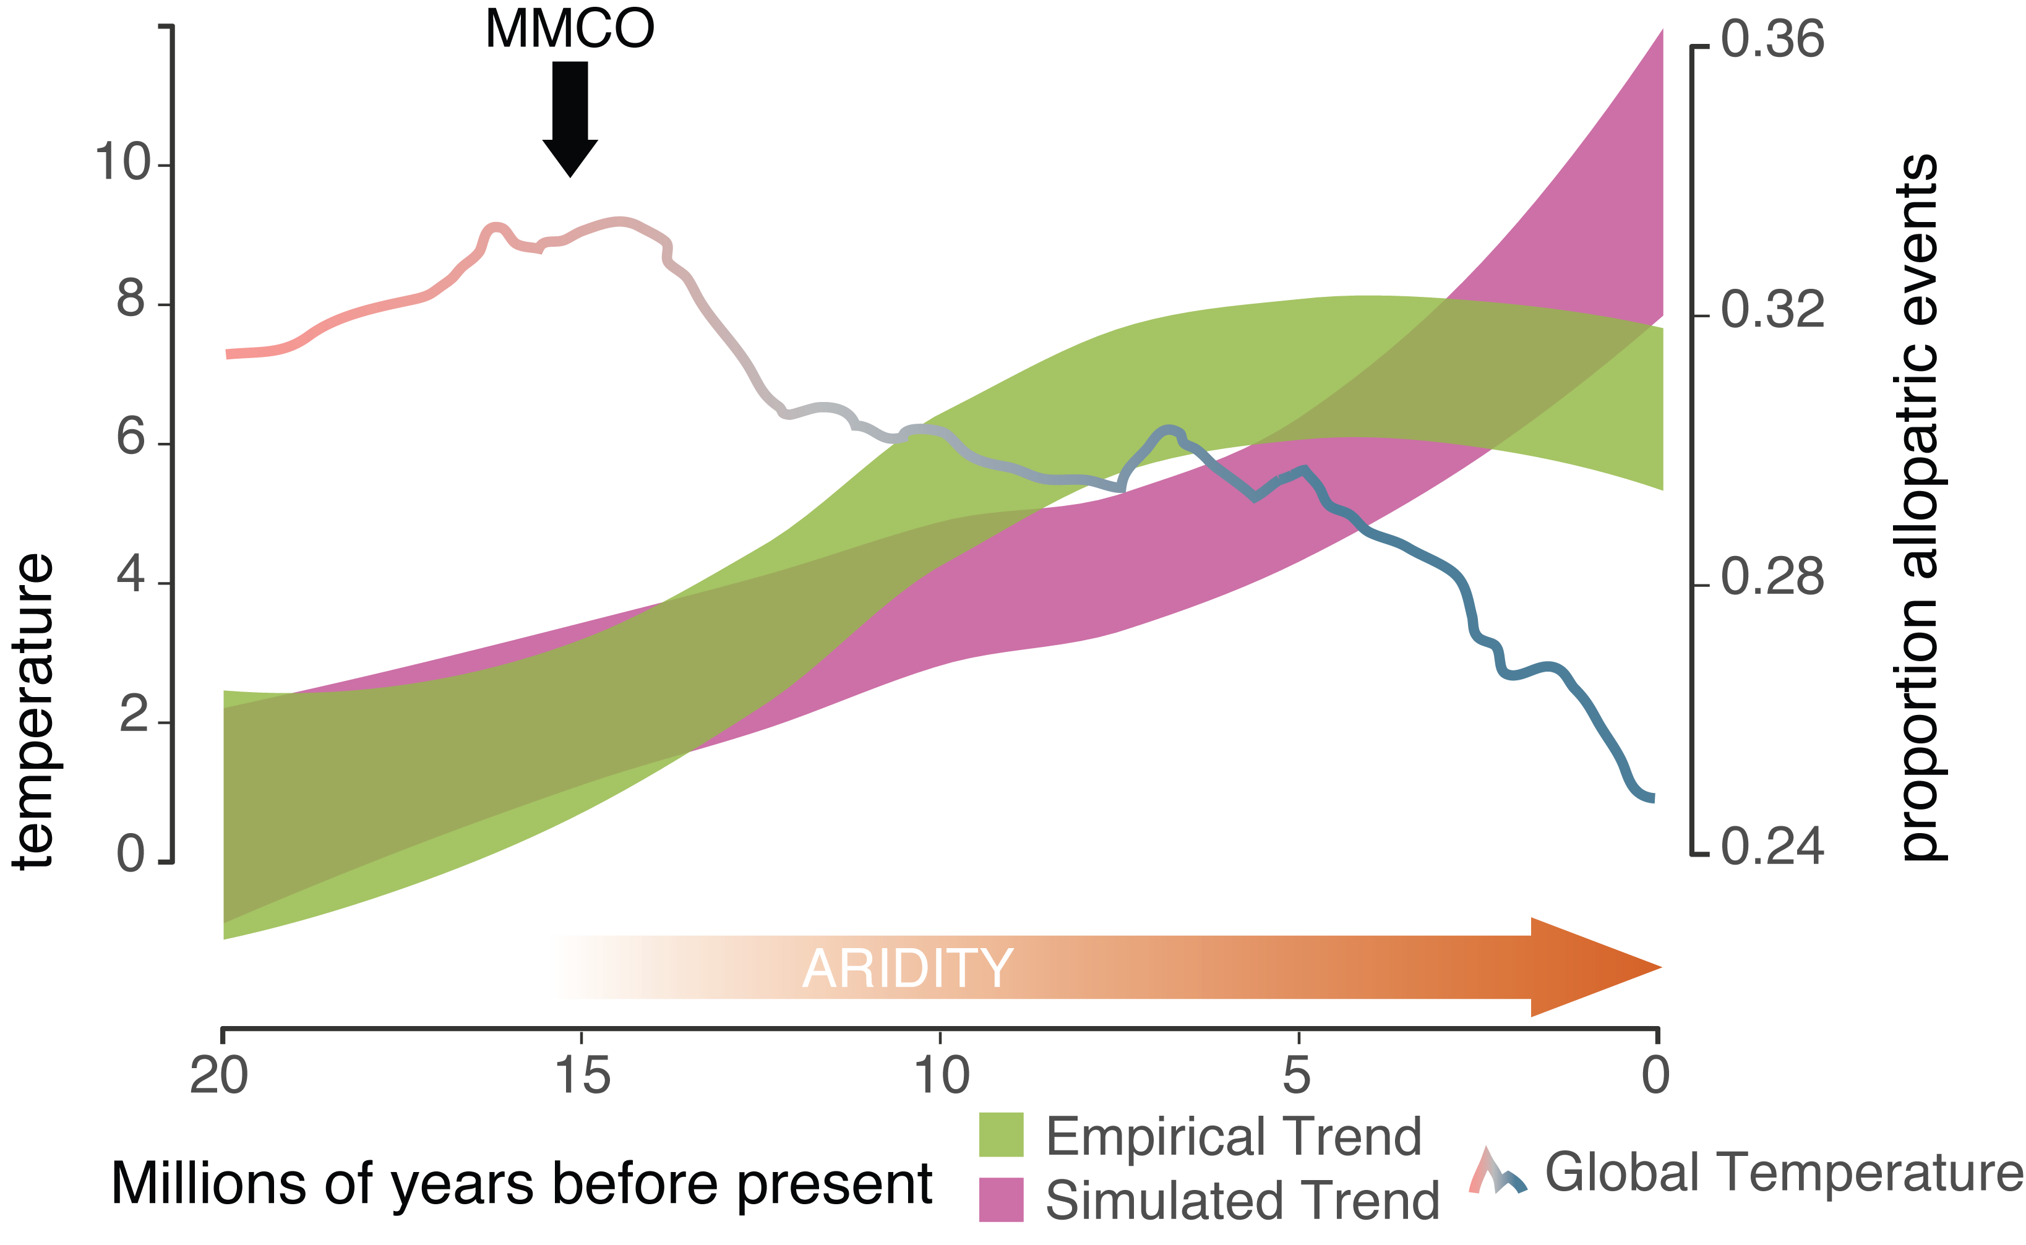

Slide 11
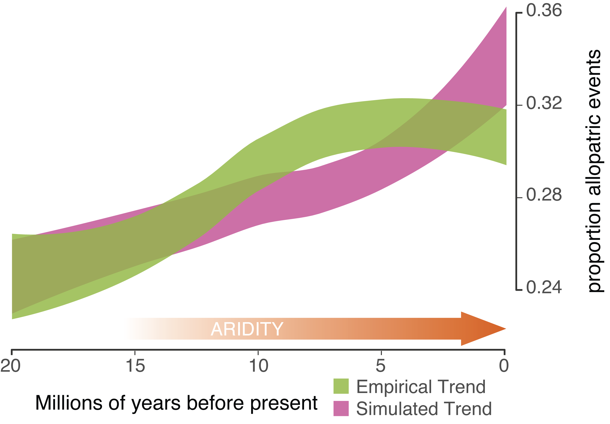

Slide 12

LET’S TRY OUR OWN, OPEN:
Iris_Plot.R (or) Iris_Plot.pdf

